Slide 1

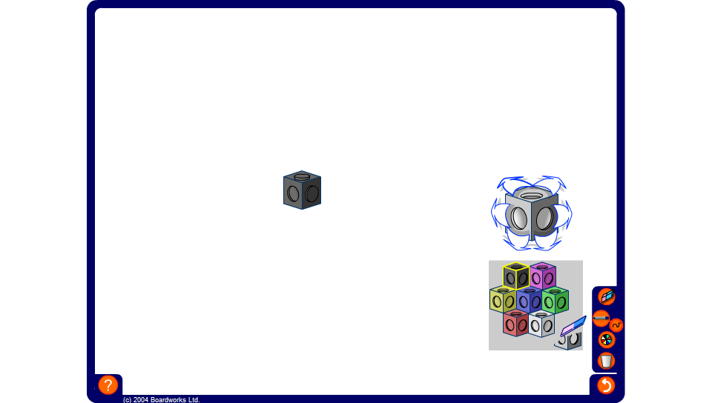


Investigating shapes made from four cubes
Notes:
Ask volunteers to come to the board and make three-dimensional shapes with given numbers of planes of symmetry. If other members of the group believe the shape constructed has more (or fewer) planes of symmetry, they should describe these fully and give an alternative shape.

